Slide 1
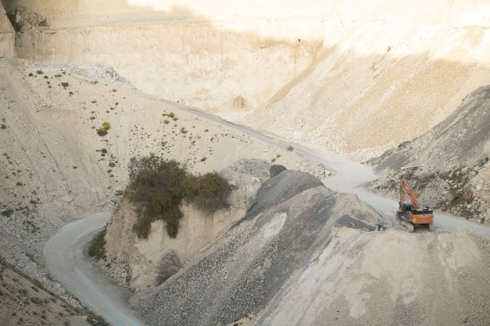
ENV 501 / GR A3 30 Exercise session 2: Jupyter Notebook tutorial
Teaching assistant:
Jair Campfens jair.campfens@epfl.ch
Fall 2024

Slide 2
Week 2 Exercises
Exercise 1
Compare the 2022 domestic material consumption (DMC) of Switzerland, Japan, and India.

Slide 3
Week 2 Exercises
Exercise 1
Compare the 2022 domestic material consumption (DMC) of Switzerland, Japan, and India.
DMC refers to the amount of materials directly used in an economy.
i.e. domestic extraction (DE) + imports – exports
CH: 93.2753// JPN:1185.475 // IND:6984.798

Slide 4
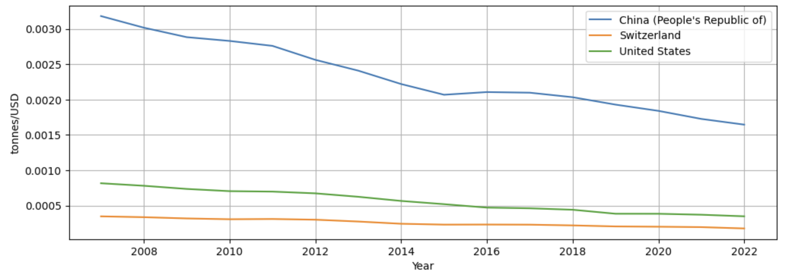
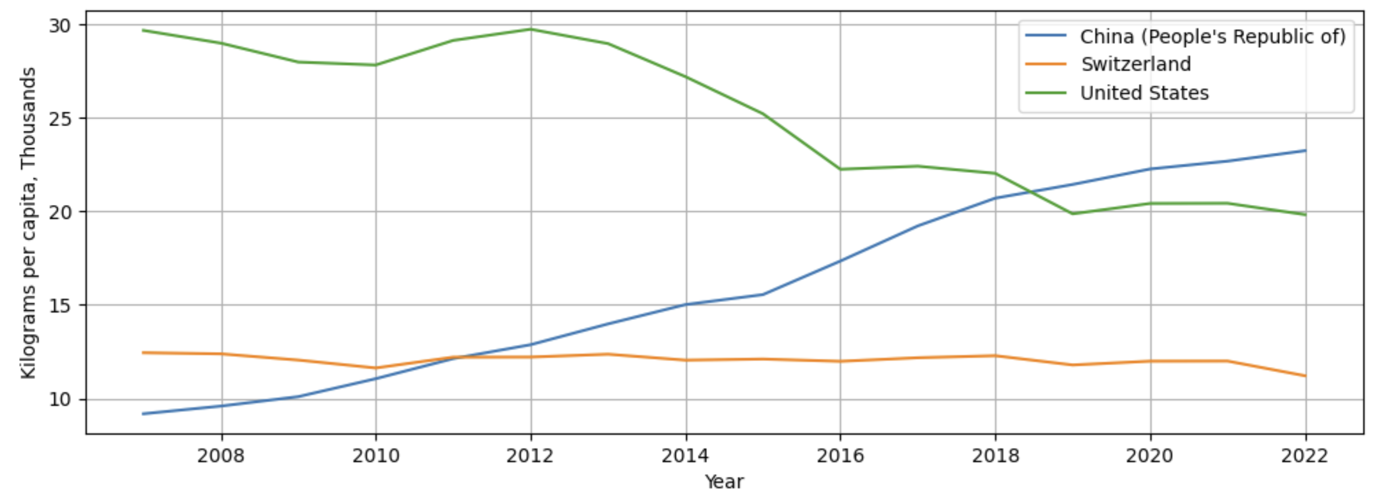
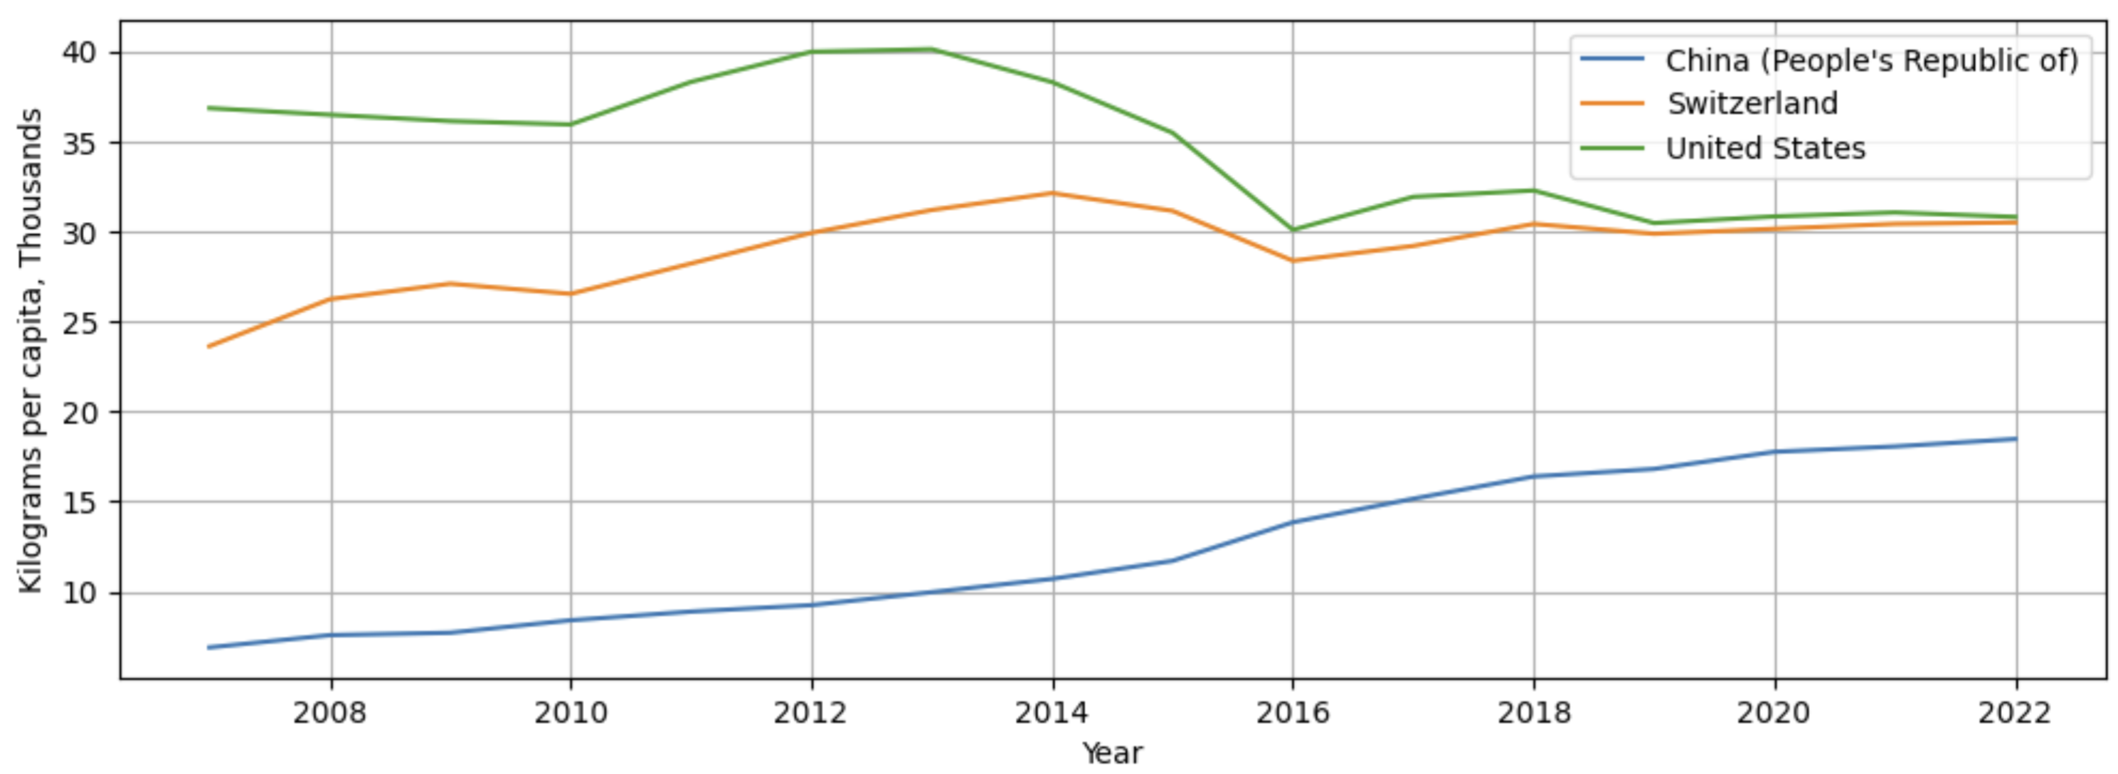
Week 2 Exercises
Exercise 1
2. Considering the GDP and population size, plot the material consumption intensity¹, per capita DMC, and per capita material footprint (i.e. RMC) of Switzerland, China, and the United States from 2007 to 2022.

Slide 5
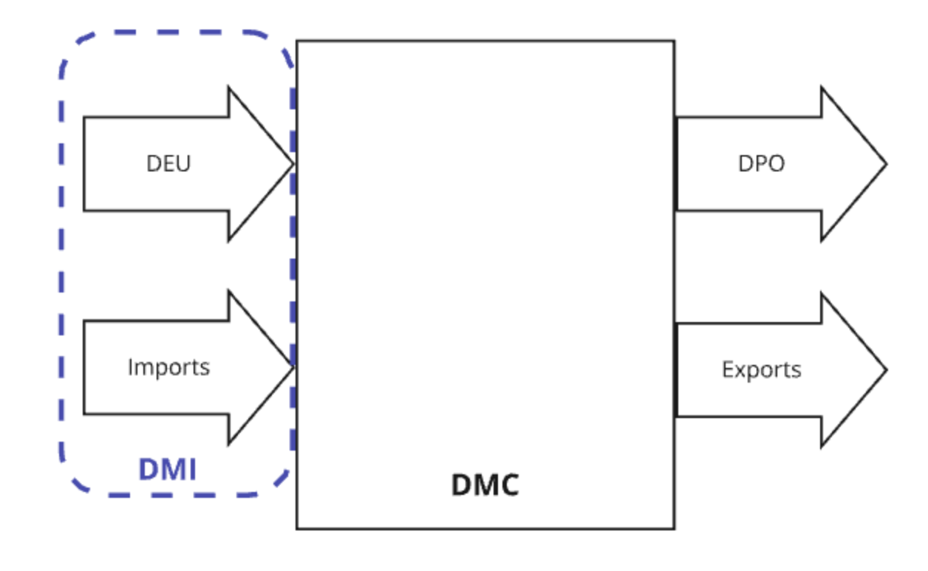
Week 2 Exercises
Exercise 2
Establish the economy-wide MFAs for France, the United Kingdom, and Spain (2022). Consider only the following flows into and out of the economy: domestic extraction unit (DEU), imports, domestic processed outputs (DPO), and exports (see Figure 1). Flows within the economy can be ignored.

Slide 6
Week 2 Exercises
Exercise 2
2. From your MFA diagrams, calculate the following indicators:
Direct material input (DMI)
DMI = DEU + IMP
FR: 925.2391 Tonnes, Millions
ES: 570.7977 Tonnes, Millions
UK: 726.4915 Tonnes, Millions

Slide 7
Week 2 Exercises
Exercise 2
2. From your MFA diagrams, calculate the following indicators:
Domestic material consumption (DMC)
DMC = DMI – EXP
FR: 734.4734 Tonnes, Millions
ES: 411.5471 Tonnes, Millions
UK:576.4485999999999 Tonnes, Millions

Slide 8
Week 2 Exercises
Exercise 2
2. From your MFA diagrams, calculate the following indicators:
Physical trade balance (PTB)
PTB = IMP - EXP
FR: 135.24769999999998 Tonnes, Millions
ES: 83.73680000000002 Tonnes, Millions
UK:123.47119999999998 Tonnes, Millions

Slide 9
Week 2 Exercises
Exercise 2
2. From your MFA diagrams, calculate the following indicators:
Resource productivity
GDP/DMI (million USD/million tonnes)
FR: 2938.9425074016003 [USD/ tonnes]
ES: 2850.1941351550645
UK:3769.0823003435007

